Slide 1
EMT GRN
Gould PLoS Comp-Bio paper
Bassen

Slide 2
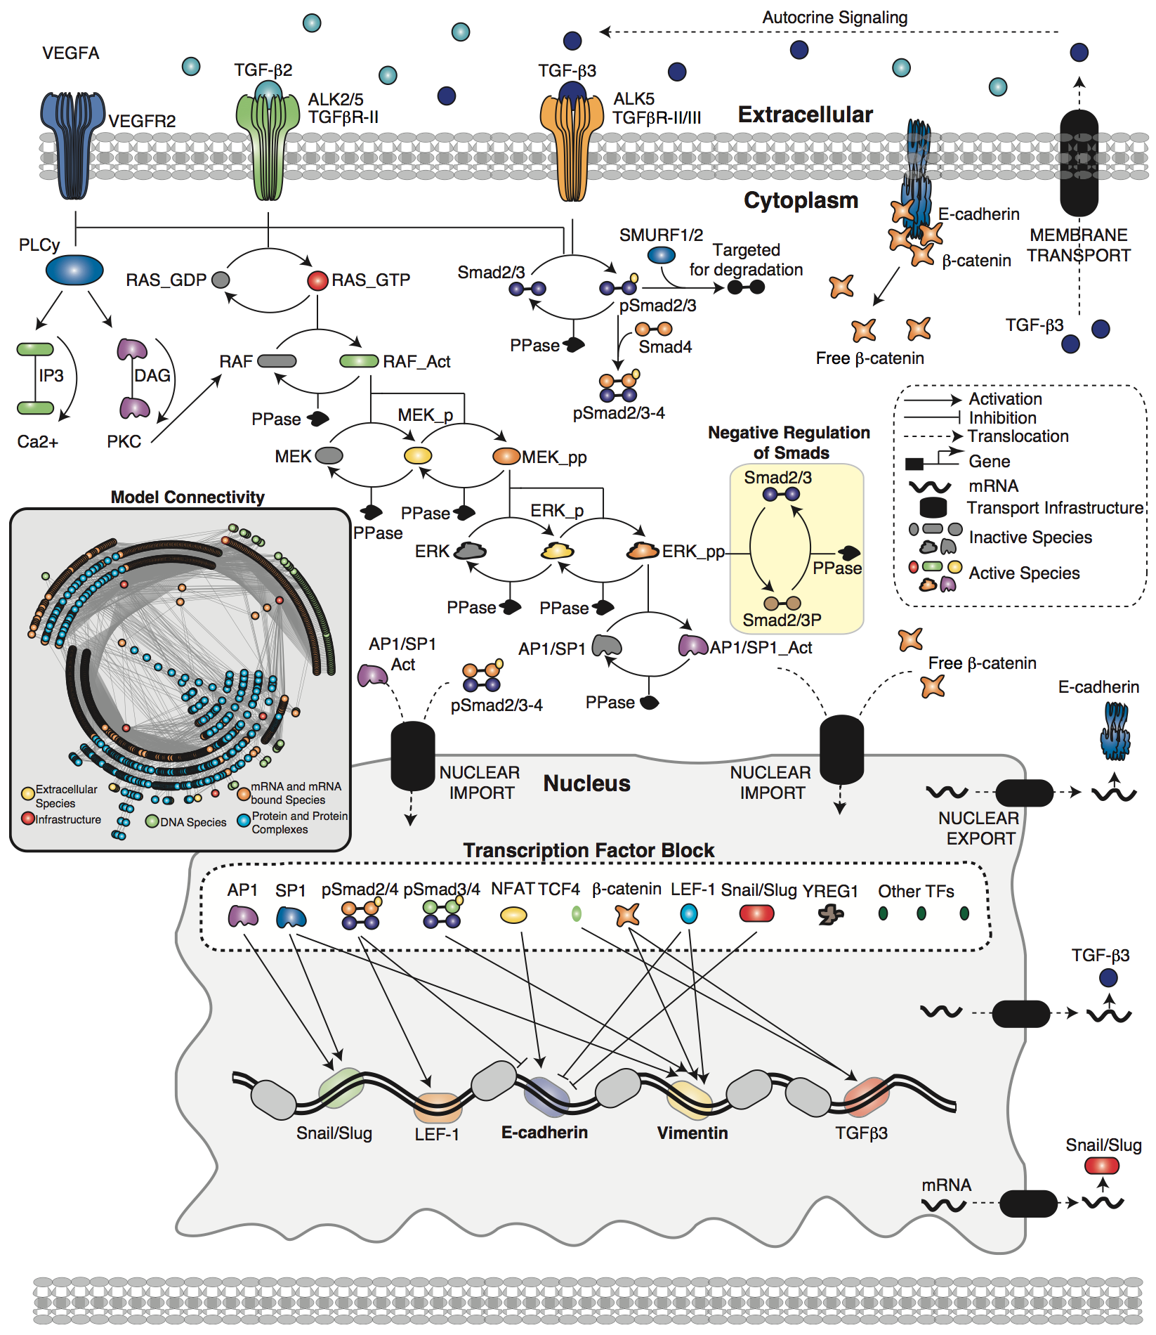
p
p
MAPK
MAPK
SMAD
p
TC4F
Active_TC4F
p
NFATC1
AP1
p
SMAD

Slide 3
Connection to NFAT
LEF1 drives vimentin in a smad dependent mechanism

Slide 6
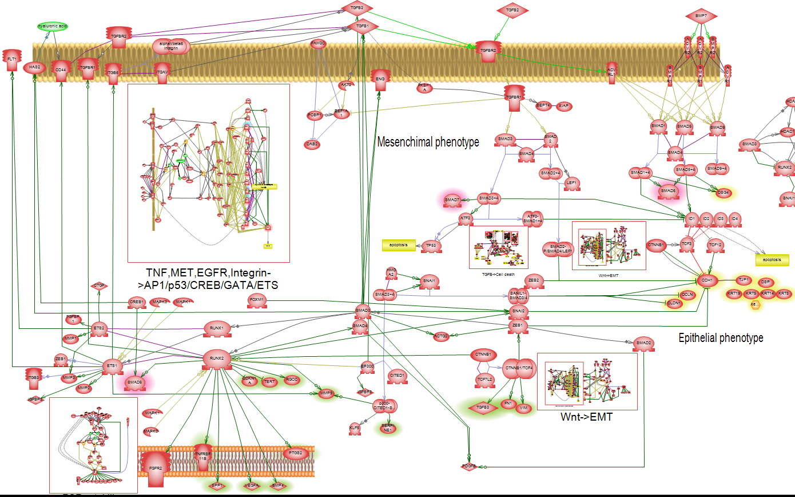
TGF-β autocrine loop sustains EMT

Slide 7
Notes:
2014 Suehiro

Slide 8
Notes:
http://www.ncbi.nlm.nih.gov/pubmed/23669445
Use as a model for review paper

Slide 9
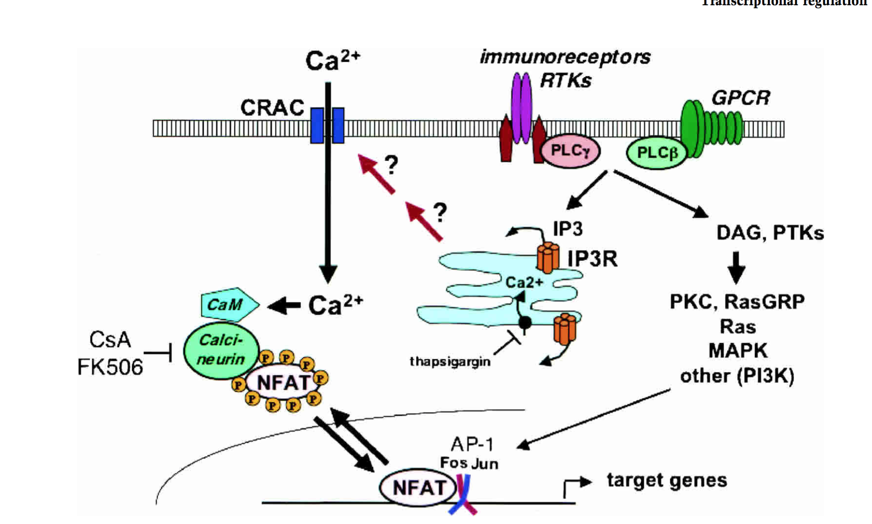
Transcriptional regulation by calcium, calcineurin, and NFAT
Patrick G. Hogan,1 Lin Chen,3 Julie Nardone,1 and Anjana Rao1,2,4
1The Center for Blood Research and 2Department of Pathology, Harvard Medical School, Boston, Massachusetts 02115, USA; 3Department of Chemistry and Biochemistry, University of Colorado at Boulder, Boulder, Colorado 80309-0215, USA

Slide 10
NFAT&SMAD??
Singh G, Singh SK, Ko¨nig A, Reutlinger K, Nye MD, Adhikary T, Eilers M, Gress TM, Fernandez-Zapico ME, Ellenrieder V (2010) Sequential activation of NFAT and c-MYC transcription factors mediates the TGF-b switch from a suppressor to a promoter of cancer cell proliferation. J

Slide 11
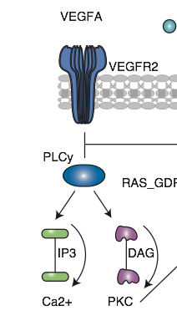
RANKL/RANK as Key Factors for Osteoclast Development and Bone
Loss in Arthropathies

Slide 12
Complex networks orchestrate epithelial–mesenchymal transitions
Jean Paul Thiery* and Jonathan P. Sleeman‡

Slide 13
Cancer, evidence VEGF ERK interaction
Notes:
http://www.sciencedirect.com/science/article/pii/S0092867409016328

